Slide 1

Smart Parking Management System
Cloud-Based Multi-API Integrated Application
Author: Meenakshi (24235415)

Slide 2
Introduction
Modern applications use microservices over monolithic architecture
Benefits: Scalability, Flexibility, Maintainability
Challenges: API communication, Distributed complexity

Slide 3
Project Objectives
Develop a user-friendly frontend interface
1
Create a custom password validation API
2
Integrate third-party and public APIs
3
Deploy the system on the cloud
4

Slide 4
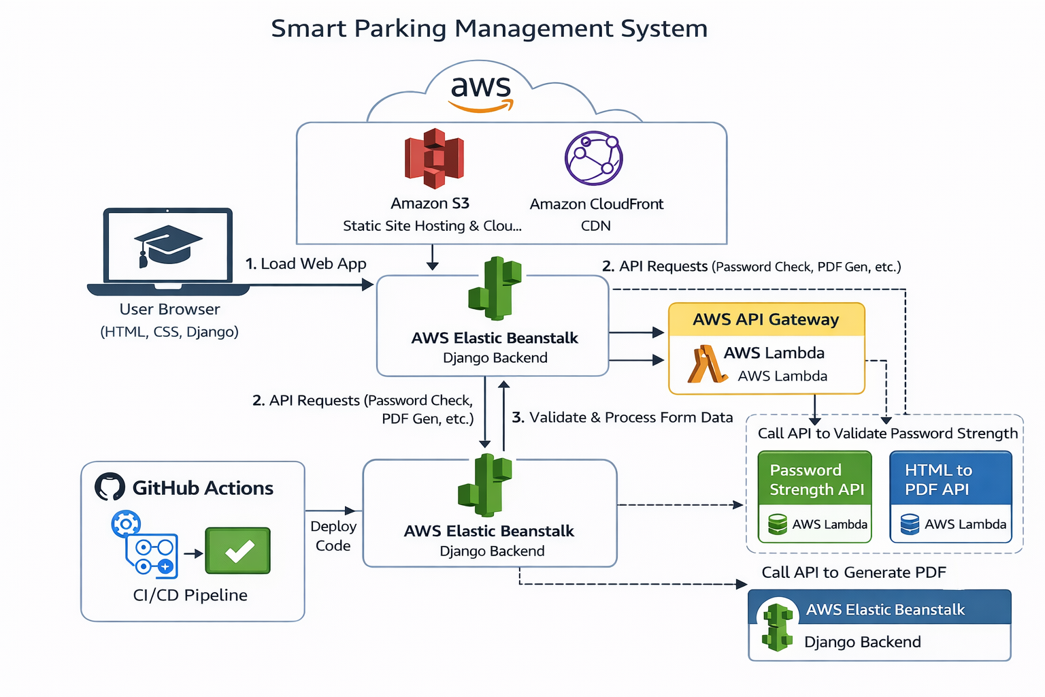
System Overview
Frontend interacts with users and sends HTTP requests
Backend processes requests and coordinates with APIs
APIs handle specific tasks like password validation and PDF generation

Slide 5
Requirements
Functional Requirements:
- Add/Delete vehicle records
- Validate password strength
- Generate PDF of vehicle details
Non-Functional Requirements:
- Scalability, Performance, Availability, Usability

Slide 6
Design Approach
Use of RESTful APIs for communication
Stateless backend design for scalability
Loosely coupled services for flexibility

Slide 7
Scalability
Cloud deployment enables horizontal scaling
Each service can scale independently
Supports multiple concurrent users

Slide 8
Frontend & Backend
Frontend: User interface for managing vehicles
Backend: Handles logic, API calls, and data processing
Communication via HTTP requests

Slide 9
API Integration
Custom API for password strength validation
External API for HTML-to-PDF conversion
Public API integrated for enhanced functionality

Slide 10
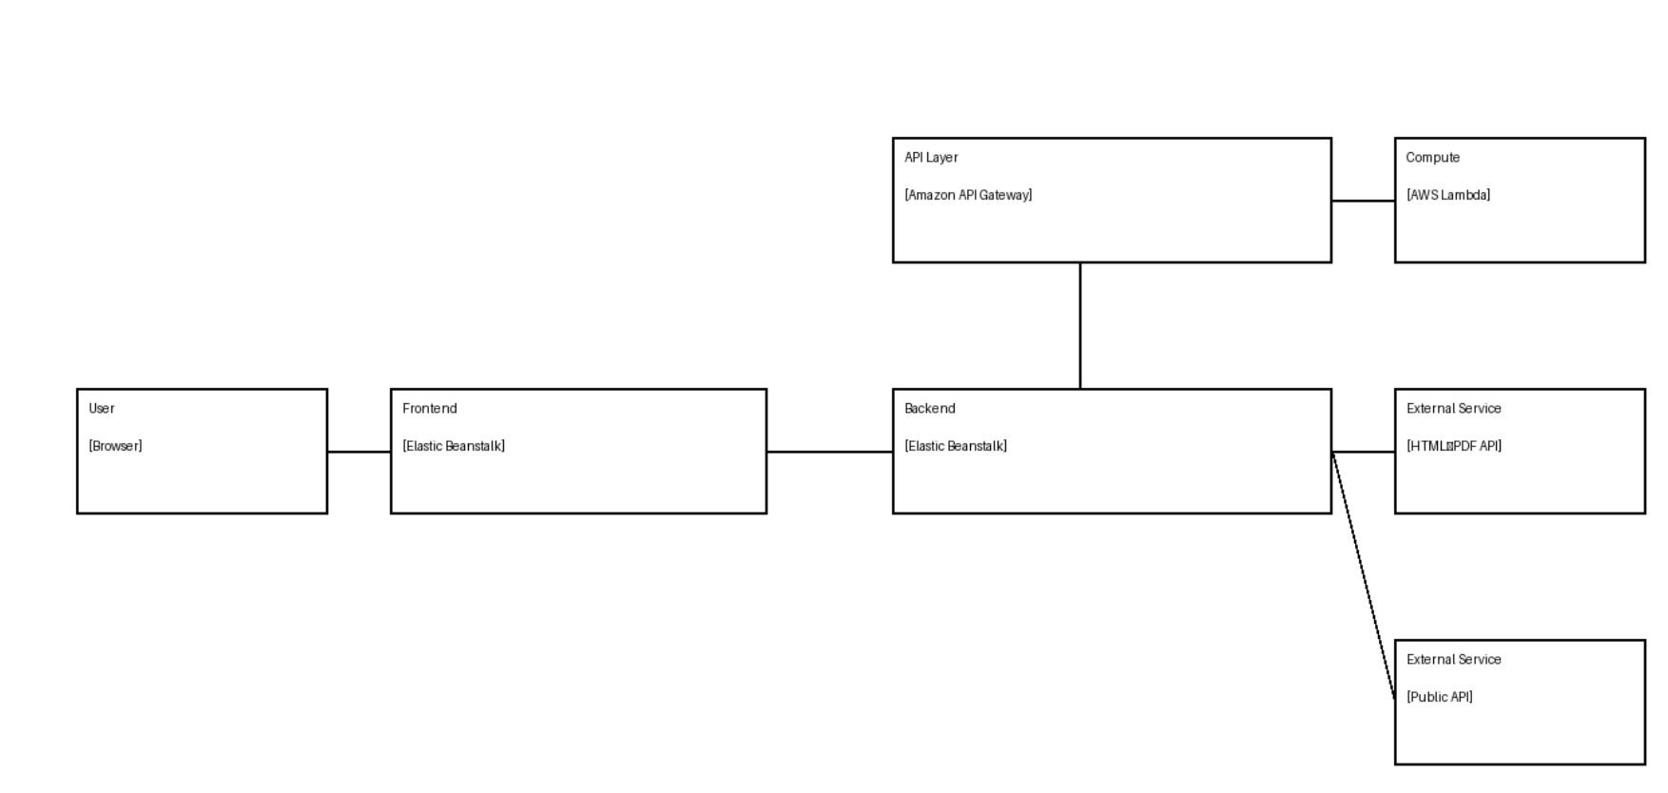
Working Flow
User inputs vehicle data via frontend
Backend processes request and stores data
On deletion, backend fetches data and sends to PDF API
PDF is generated and stored or downloaded

Slide 11
Deployment & CI/CD
Application hosted on cloud platform
Automated deployment using GitHub Actions
Continuous Integration and Delivery pipeline

Slide 12
Conclusion
Learned integration of multiple APIs
Gained experience in cloud deployment
Developed understanding of scalable system design

